Slide 1
Environmental Impact Assessment and the BBNJ Treaty
Workshop on BBNJ for CPLP Countries
Lisbon, Portugal
13-15 May 2024
Peggy Kalas
International Ocean Policy Advisor
Oceano Azul Foundation
peggykalas@gmail.com

Slide 2
What is an Environmental Impact Assessment?
Part IV – 13 Articles
Already required under UNCLOS (art. 206)– BBNJ Treaty operationalizes
Art 1 Definition: “A process to identify and evaluate the potential impacts of an activity to inform decision-making”
(Art. 1)

Slide 3
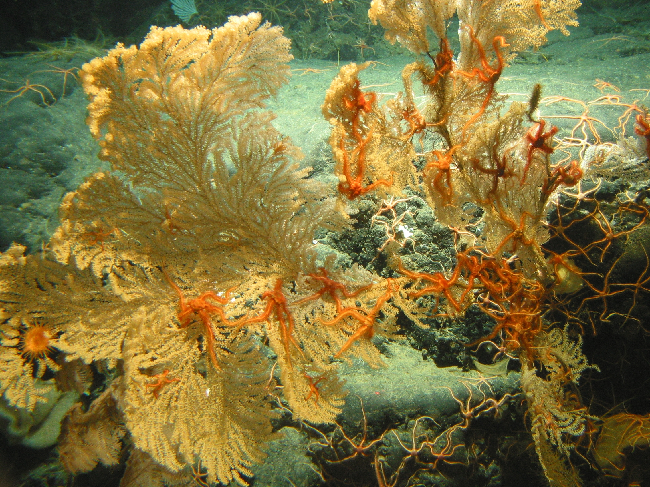
Objectives
Notes:
Gulf of Alaska Seamount Expedition. Large primnoid coral loaded with brittle stars on Dickins Seamount.
Image ID: expl0125, Voyage To Inner Space - Exploring the Seas With NOAA Collect Location: Pacific Ocean, Gulf of Alaska Credit: Gulf of Alaska 2004. NOAA Office of Ocean Exploration Category: Ocean exploration/Deep sea coral/
https://www.photolib.noaa.gov/htmls/expl0125.htm

Slide 4
Objectives of Part IV (Art. 27)
Operationalize UNCLOS’ provisions on EIAs (Art. 206)
(b) Ensure that activities are assessed and conducted to prevent, mitigate and manage significant adverse impacts
(c) Support the consideration of cumulative impacts and impacts in areas within national jurisdiction;
(d) Provide for strategic environmental assessments;
(e) Achieve a coherent EIA framework for activities in areas beyond national jurisdiction; and
(f) Build and strengthen the capacity of Parties, particularly developing States Parties to conduct and evaluate EIAs

Slide 5
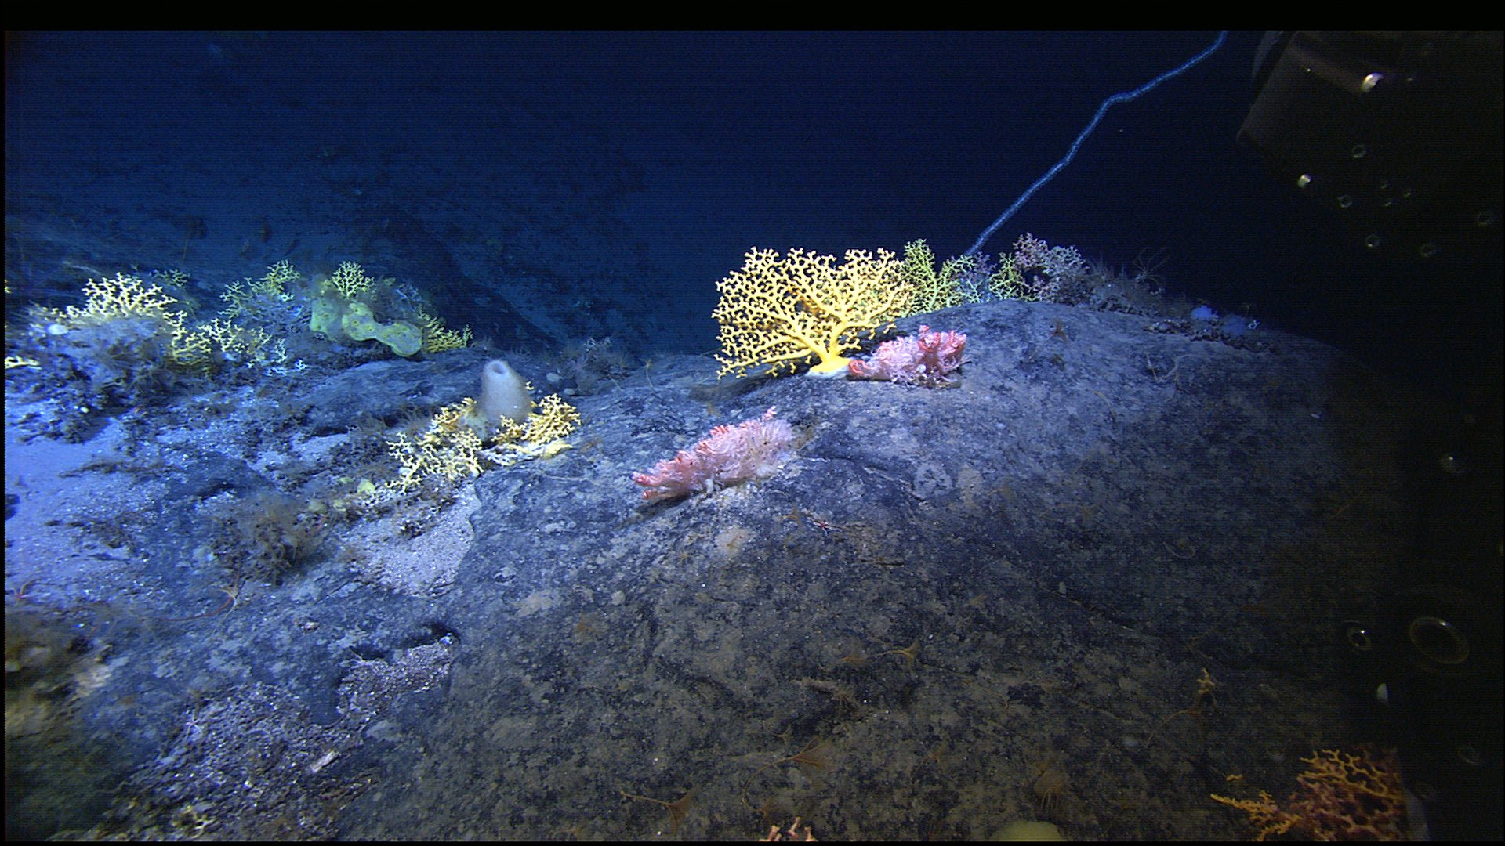
Who is responsible to conduct an EIA?

Slide 6
Subtitle\
Obligation to Conduct an EIA-Art 28
• For Planned activities which take place in ABNJ, Parties with jurisdictional or control, shall ensure that the activities are assessed before being authorized.
• For activities taking place within national jurisdiction that may cause substantial pollution, or significant changes to the marine environment in ABNJ, parties shall ensure that an EIA is undertaken via Part IV or under the Party’s national process.

Slide 7
Who is responsible to Conduct an EIA?
In this specific case, if a State Party conducts such an assessment under its national processes, it must:
(a) Make relevant information available through the Clearing-House Mechanism;
Ensure that the activity is monitored in a manner consistent with the requirements of its national process;
Ensure that EIA reports and any relevant monitoring reports are made available through the Clearing-House Mechanism

Slide 8
Thresholds for conducting an EIA? Art.30
Screening: if a planned activity may have more than a “minor or transitory impact” or the effects of the activity are unknown or poorly understood . . .
If based on screening there is reasonable grounds for that activity may cause substantial pollution or significant and harmful changes to marine environment, then an EIA to be undertaken
Scoping of potential impacts
Impact assessment and evaluation
Prevention, mitigation and management of potential adverse effects
Public notification and consultation (art. 32)

Slide 9
Subtitle\
When is Screening/EIA not Required? Art. 29(4)
When the thresholds are not met OR
If is determined that:
the potential impacts of the planned activity has been assessed by an IFB and,
The assessment is equivalent to Part IV requirements and results are taken into account; OR
The regulations/standards of IFB arising from the assessment are designed to prevent, mitigate or manage potential impacts below Part IV threshold and have been complied with.

Slide 10
Process for EIAs (Art.31)_
(a) Screening + call in Mechanism
(b) Scoping of potential impacts (cumulative)
(c) Impact assessment and evaluation -BAS
(d) Prevention, mitigation and management of potential adverse effects
(e) Public notification and consultation

Slide 11
Environmental impact assessments
Relationship between BBNJ and EIAs under IFBs (Art. 29)
1. Parties are required to promote the use of EIAs and standards/guidelines of which they are members.
2. The COP will develop mechanisms for the Scientific and Technical Body (STB) to cooperate with IFBs on EIAs
3. When developing standards or guidelines under Art 38, STB shall collaborate with IFBs

Slide 12
Strategic Environmental Assessment (SEA) – Art. 39
An SEA is undertaken at an earlier stage to assess the potential effects of a plan or programme, as well as alternatives, on the marine environment
The agreement provides that States Parties can “consider” conducting SEAS, and leaves this to the CoP to further delineate at future date.

Slide 13
Environmental impact assessments
Decision-making Art. 34
Decision-making: The BBNJ Agreement leaves both the responsibility to conduct an EIA and the subsequent decision whether to allow the activity to the Party under whose jurisdiction or control a planned activity falls, but it establishes public notification and consultation obligations which greatly improve transparency.
“Call in” Mechanism (Art 31): Other Parties can also register concern about specific activities, and the possibility for a review and recommendations by the STB creates further accountability.
Subtitle\

Slide 14
Capacity Building

Slide 15
CAPACITY BUILDING
A roster of experts to be created under the Scientific and Technical Body.
Parties with capacity constraints may request advice and assistance from those experts to conduct and evaluate screenings and EIAs
Parties may conduct joint EIAs for panned activities under the jurisdiction or control of SIDs
CBTMT Committee – guidance on needs assessment

Slide 16
The STB will be composed of members serving in their expert rather than national capacity, taking into account the need for multidisciplinary expertise, gender balance and equitable geographical representation.
Open questions: The terms of reference and modalities of both the STB and CBTMT, including its size and exact composition, as well as the selection process and terms of members mandates remain to be determined by the CoP.

Slide 17
Subtitle\
Environmental impact assessments
Key Messages
States need to:
Ensure that decision-making for activities under their jurisdiction or control is in accordance with the BBNJ requirements.
Determine if their national EIA regimes would meet requirements to be exempted from EIA-obligation under BBNJ for certain activities within national jurisdiction.
Determine if existing activities in ABNJ regulated by other IFBs would meet requirements to be exempted from EIA-obligation under BBNJ.
A number of mechanisms and guidelines will need to be developed by the CoP and STB to fully implement the EIA provisions

Slide 18
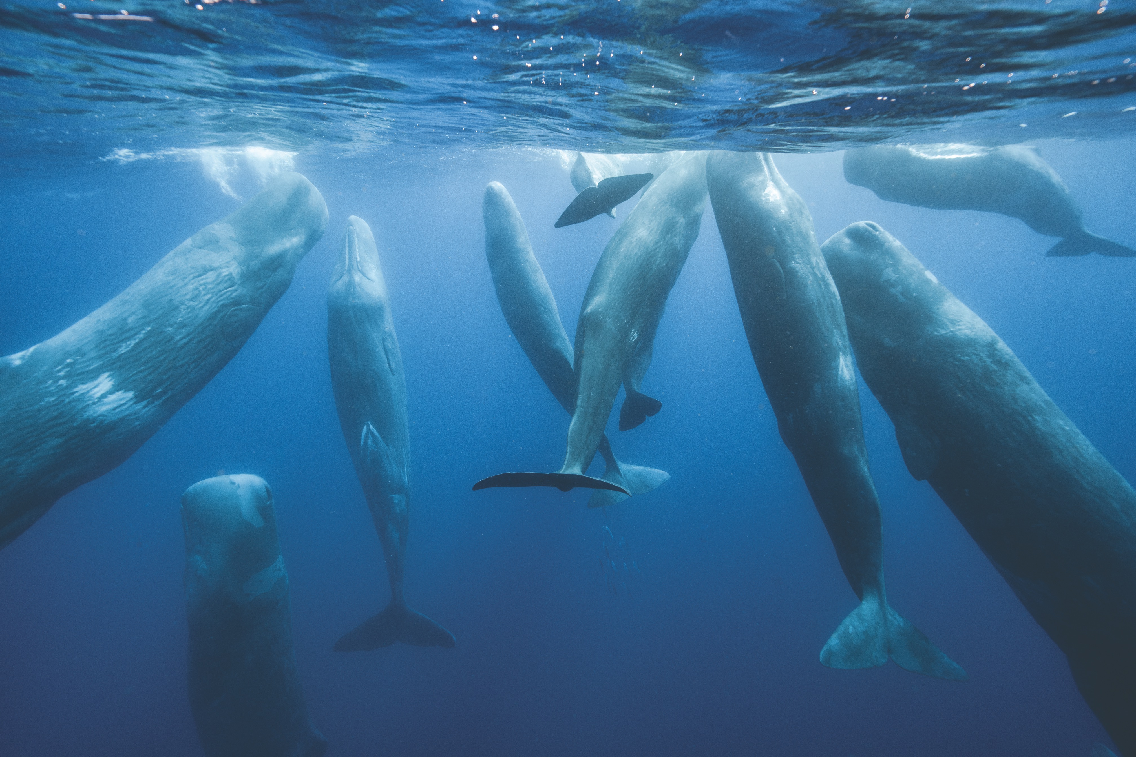
Muito Obrigada! Questions??
Muito Obrigada! Questions?

